Slide 1
How to request space for your meeting/event with the EMS WebApp
Vermont Tech Conference & Events

Slide 2
The Basics
EMS WebApp has replaced VEMS (Virtual Event Management System). This is the software Vermont Tech (and the VSC) is using for room and event scheduling.
This tutorial is designed to teach Vermont Tech users how to request a space on the Randolph Campus.
Space requested through the EMS WebApp MUST be requested a minimum of 24 hours in advance. If your needs are more urgent, please contact the Conference & Events Office x71607
Catering requested through the EMS WebApp MUST be requested a minimum of 7 days in advance.
In addition to checking the EMS WebApp, you can also view non-academic course events already scheduled on the Master Calendar website events.vtc.edu.

Slide 3
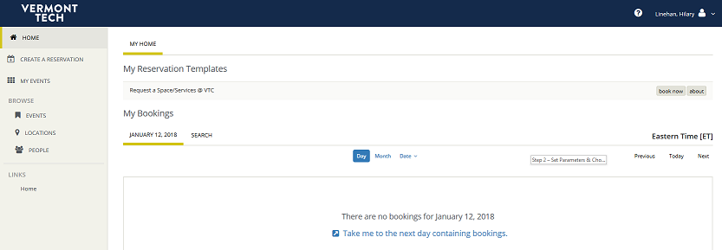
Step 1
Using Virtual EMS
Go to http://events-tc.vsc.edu/EMSWebApp/Default.aspx
Click on “Log In”. You will be prompted to log-in if you if you are not already in the portal.
Log in with your usual VTC credentials. Your screen should look like this after you have logged-in:

Slide 4
Step 2 –Choose a room
Using Virtual EMS
Click on “Create a Reservation” in upper left corner
Click on “Book Now” in upper right corner
Set your parameters :
Set the date for your request
Set a recurrence if applicable
Set the time you need the room
Under Locations, ensure it lists VTC Randolph
Click the blue “Search Button”
The list will show all rooms available
If you want to look for room in a specific building:
Click on Add/Remove next to locations
Click on the building you want (or click on multiple buildings)
Click on Update Locations
The list will display only the buildings you have selected

Slide 5
Step 2 – continued
Using Virtual EMS
All spaces that meet the criteria you set will be shown in the list.
If there is gray in the space/room you want, that means it is unavailable during the time it is grayed out.
Click on the “+” button for the room you want
Enter the # of people and setup type (use standard/as is if you are unsure)
Click on add room – your room will show up on top under “Selected Rooms”
If you have made a mistake, you can click on the “-” sign to remove the room and pick a different room
Click on the blue “Next Step” button in the upper right corner

Slide 6
Step 3 – Add catering
Using Virtual EMS
If you require catering, ensure your event start and end time are accurate.
Leave the “Service Type” as delivery UNLESS you are ordering dining hall meals, then change to Dining Hall Meals
Enter your G/L # for the catering charges
add any food item or dining hall meals:
click on the category you want
Click on the item you want
Verify the quantity - You may want less of some items than the # of people, if you want multiple selections.
All of your selections will display on the right side of your screen.
Click the blue “Next Step” button in the upper right when finished

Slide 7
Step 3 – Add furniture – only for Judd, Campus Center, Langevin
Using Virtual EMS
If you require additional furniture in the above listed rooms:
click on the category you want
Click on the item you want
Enter the quantity
If you have special instructions for how you want the items set up in a particular way, please indicate these under “how would you like the above set up?”
All of your selections will display on the right side of your screen.
Click the blue “Next Step” button in the upper right when finished

Slide 8
Step 4 – complete event info
Using Virtual EMS
Enter the event name
Enter the event type
Leave Department as VTC-Institutional Support.
Find your name from the list under 1st Contact. If you want someone else to be the contact use their name, or put in temporary contact and type in the name, phone and e-mail.
In the box under “Event Description for Calendar” type in a description if you want anything to display on the web events calendar.
Click the green “Create Reservation” button on the bottom right.

Slide 9
Changes to a reservation
Using Virtual EMS
If you want to change your reservation before it has been approved, log back in, and go to My Events in the upper left of the screen.
Click on your booking, then click on the pencil icon
Change your parameters, then click on Update Booking OR
Under My Events click on “Booking Tools”
Choose what you want to change and make adjustments
If you want to cancel a reservation, log back in and go to My Events in the upper left of the screen
Click on your booking, then click on cancel Bookings
Select the booking you want to cancel
Click on the blue “Cancel selected Bookings” button
If a reservation has been denied, it will not appear in your list

Slide 10
Confirmation of request
Using Virtual EMS
If there are any questions about your request, you will be contacted directly.
If there is a problem or conflict, your request will be denied and you will receive a e-mail confirmation from Mary Jeanne Taylor listing the event as (Denied)
If there are no issues, your request will be approved and you will receive an e-mail confirmation from Mary Jeanne Taylor.
Questions about using the EMS WebApp should be directed to Hilary Linehan hlinehan@vtc.edu or x71794.

